Slide 1
CS-663 Project
Image Stitching to create Panorama

Slide 2
Project Team Members
210020130 Shivesh Gupta
210020120 Saumya Sheth
210070085 Siddhant Chourasia

Slide 3
Overview
The project is dedicated to creating meaningful collages by aligning and blending different images, utilizing advanced image warping and stitching techniques.
The project is significant for its potential applications in enhancing digital documentation processes and improving panoramic photography techniques, making it relevant in both academic and practical domains.

Slide 4
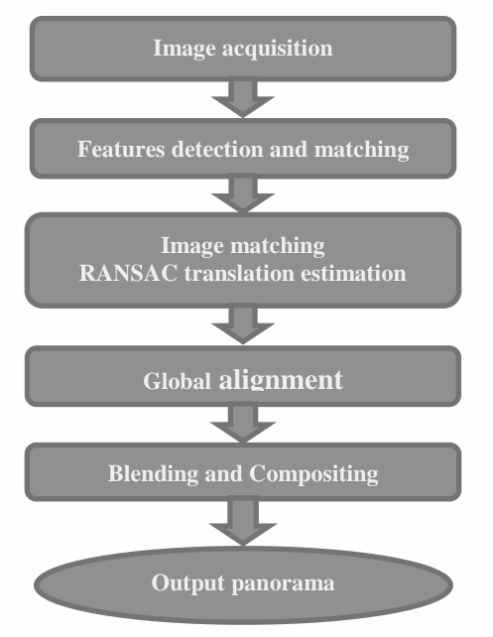
Methods
Feature Detection Algorithm -
ORB (Oriented FAST and Rotated BRIEF) & SIFT (Scale Invariant Feature Transform)
Key Point Matching Algorithm -
BF (Brute Force)
Homography Matrix Construction Algorithm - RANSAC (Random sample consensus)
Image Blending -
Weighted Sum of the images

Slide 5
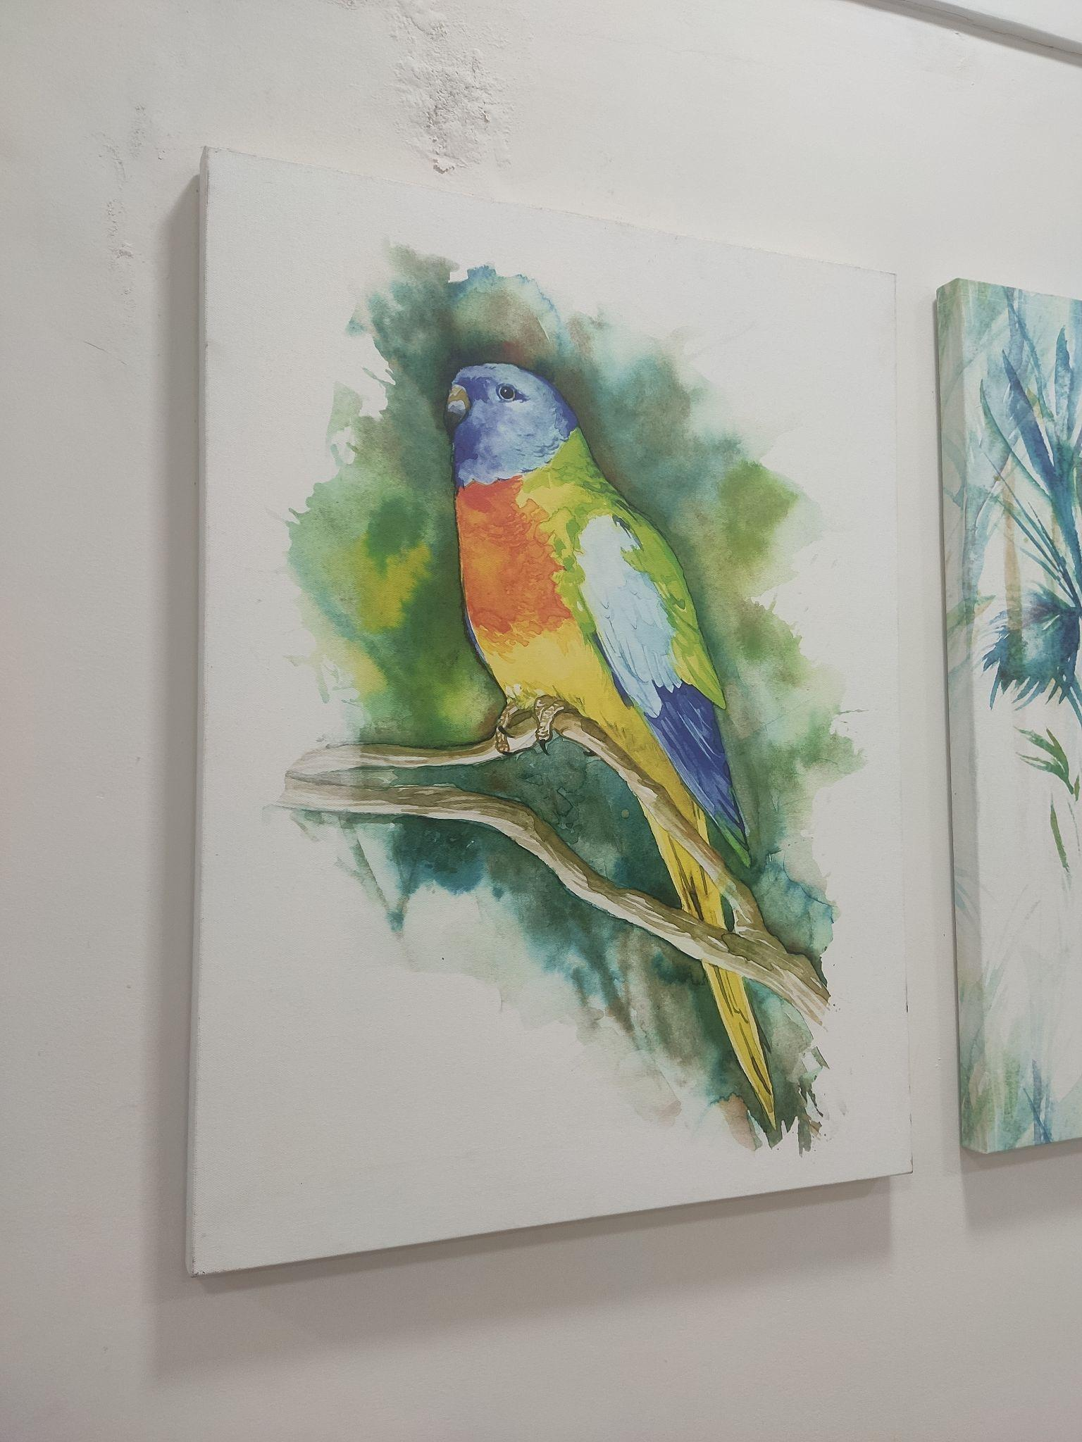
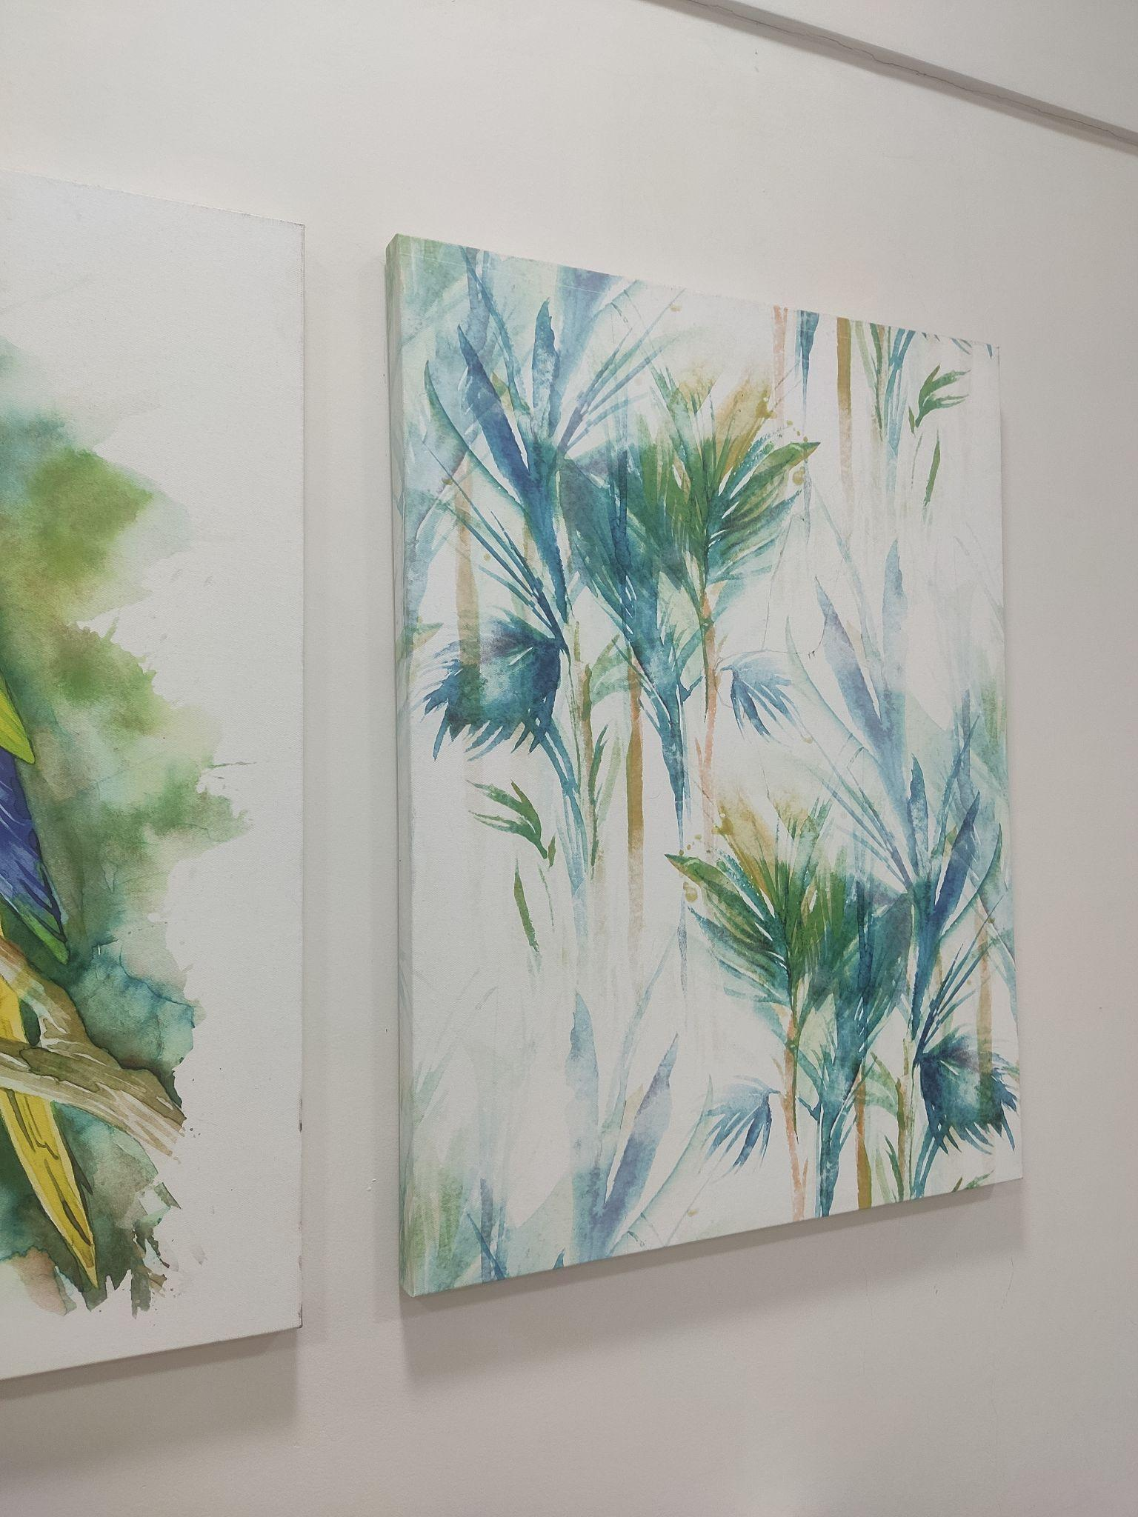
Results

Slide 6
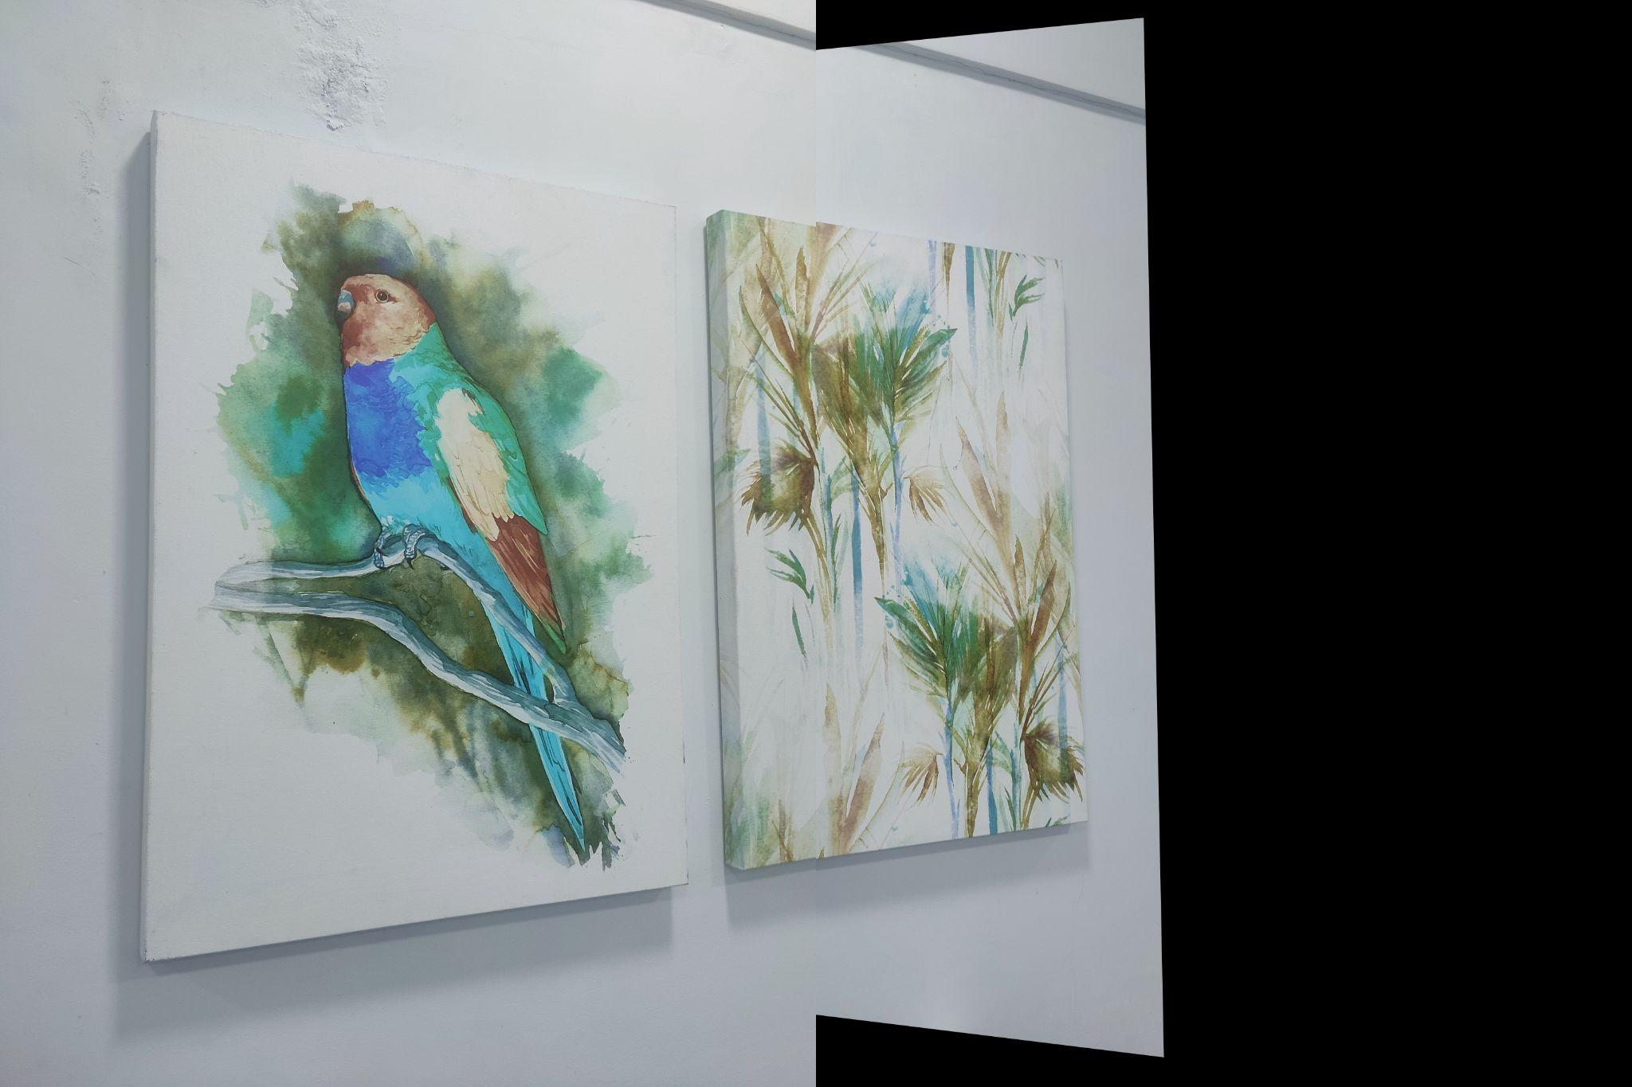
Results

Slide 7
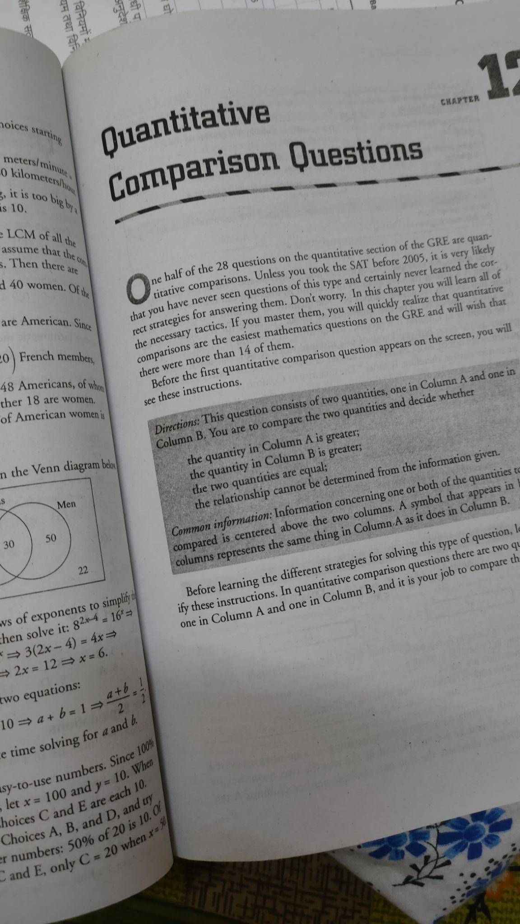
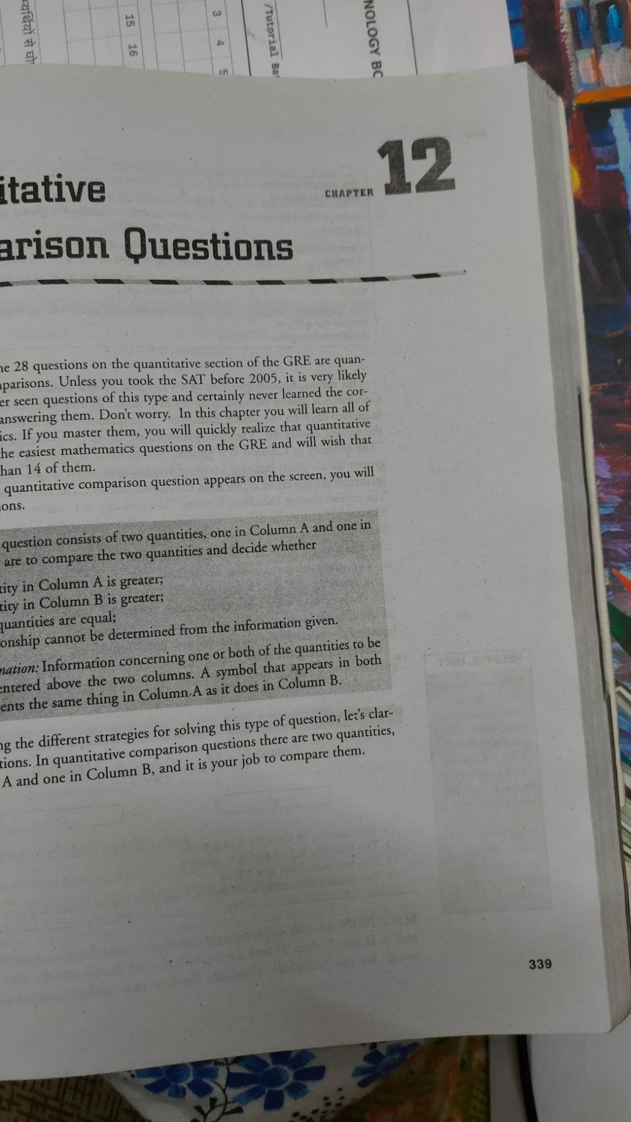
Results

Slide 8
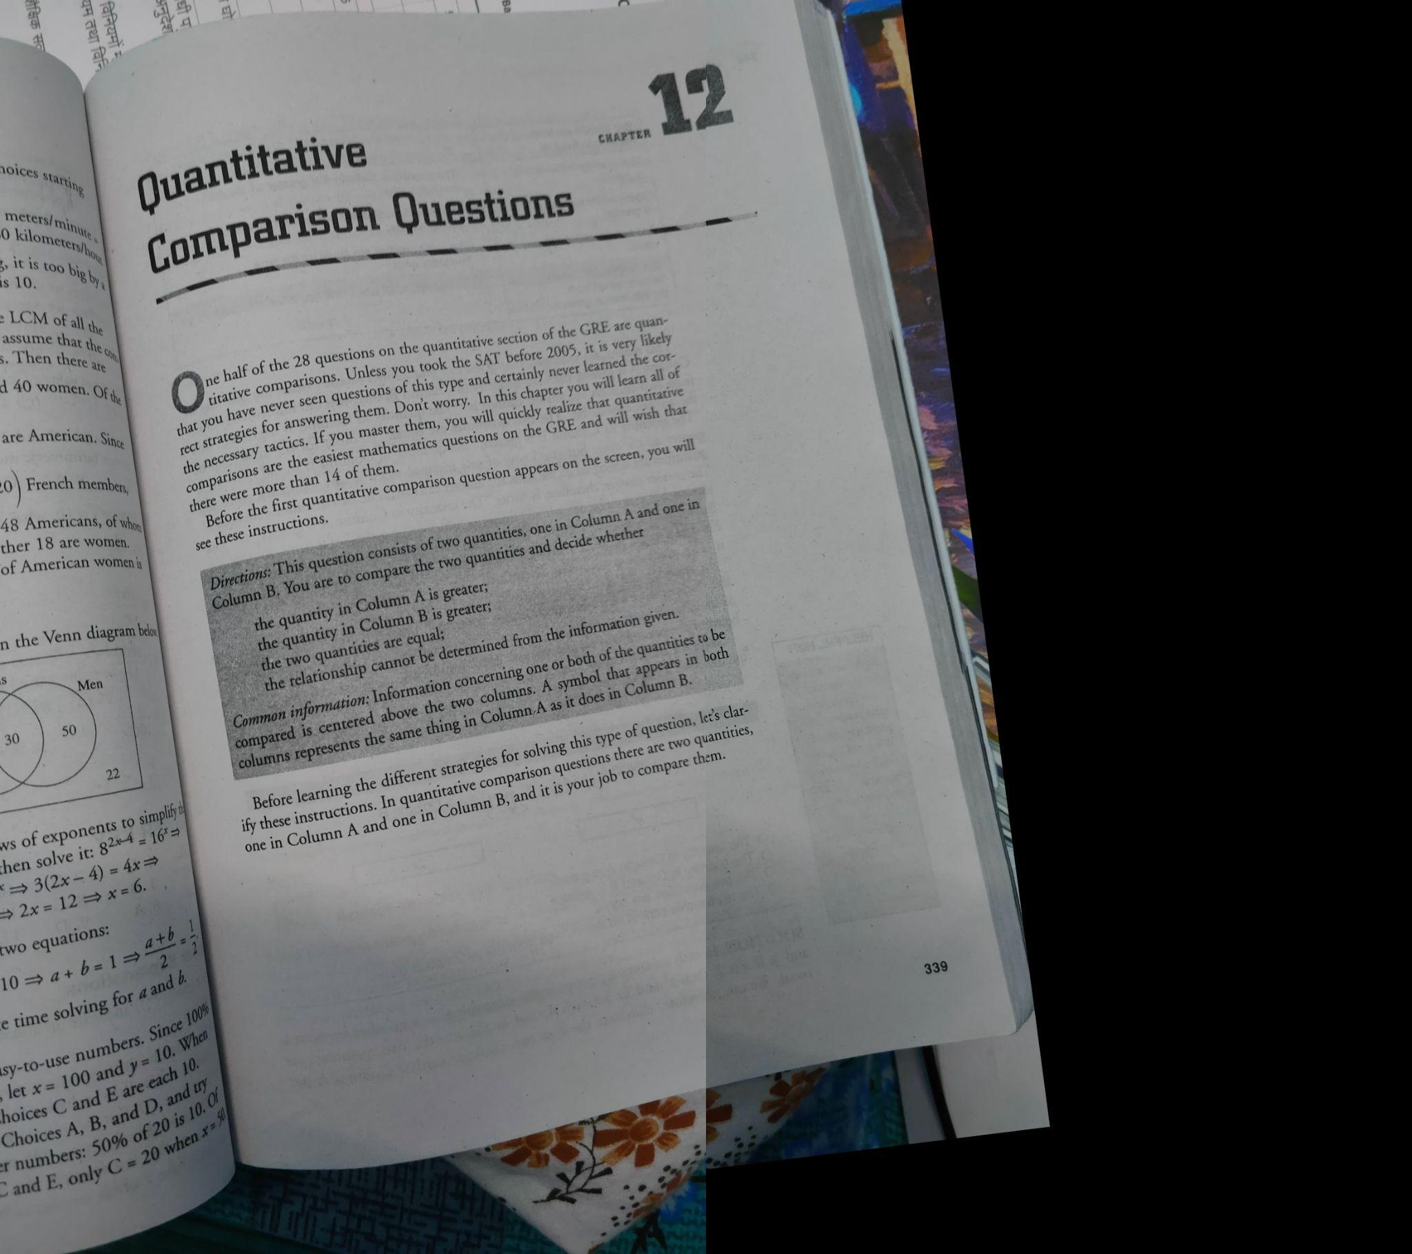
Results

Slide 9
Limitations
Our algorithm can stitch and blend only 2 images at a time, but we can always stitch more than 2 images by first stitching 2 images and then choosing the output as the next input image
For this algorithm to work, the images must be placed in order.

Slide 10
References
[1] Iretiayo Akinola, Zhouyang Li, Amit Badlani, "Mobile Page Scanner" Electrical Engineering, Stanford University, Stanford, California 94305, USA
[2] Ebtsam Adel, Mohammed Elmogy, Hazem Elbakry, (August 2014) "Image Stitching based on Feature Extraction Techniques: A Survey" International Journal of Computer Applications (0975–8887) Vol 99– No.6

